Slide 1
Hunger in Monterey County 2020 Monterey County Health Department
It wasn’t my turn to eat dinner *
*A Monterey County elementary school teacher in 2013 was instructing her students on healthy nutritional choices. Going around the room, students were asked what they had for dinner on the night before. “Nothing,” one boy answered, “It wasn’t my turn to eat dinner.”

Slide 2
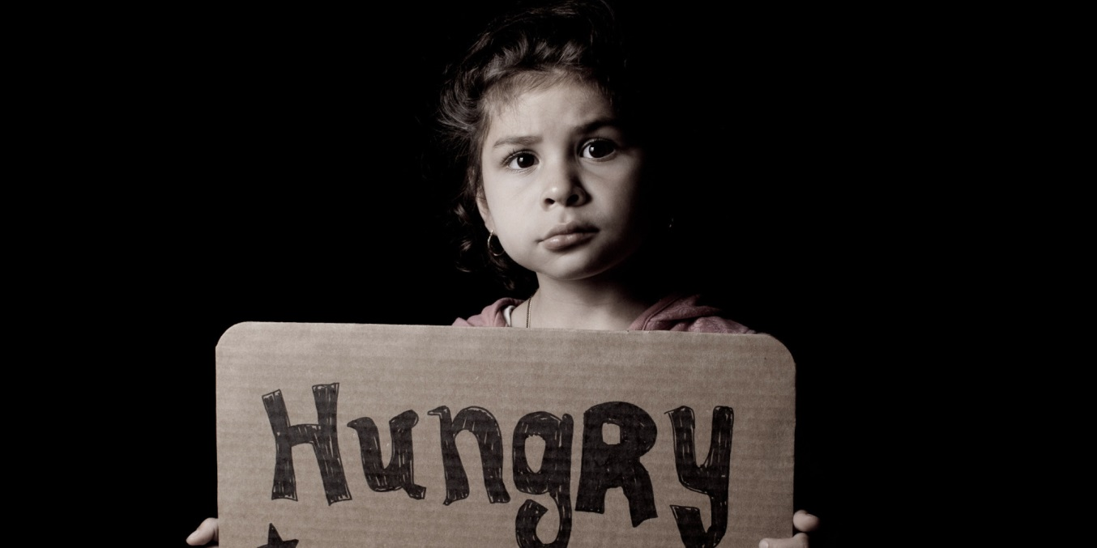
17,380 Monterey county children experienced food insecurity in 2018.
15.2% of children (under 18) do not have enough to eat.
Feeding America, 2018
Monterey County: 3 Largest Demographics living in Poverty
1
2
3
Female 25-34
Female 6-11
Male 6-11
Census Bureau, 2017
Food insecurity
2018
Can’t afford enough food
2011-2017
Monterey County Residents
29%
Cant Afford Enough Food
CA Health Interview Survey
CA Health Interview Survey

Slide 3
Food Insecurity most often affects vulnerable populations such as: women, low income households, and those of Latinx origin. CHOMP CHA, 2019
Monterey County residents participating in WIC by race
2018
Food cost to Income ratio:
for a single parent household with 2 children in Monterey County
MIHA, 2013-2015
23% of
Monterey County’s
women experienced food insecurity during pregnancy
11.4%
KidsData.org
Food insecurity is a household economic and social condition of limited or uncertain access to adequate food.
Hunger is an individual-level physiological condition that may result from food insecurity.
USDA Economic Research Service
3
California Budget & Policy Center, 2017

Slide 4
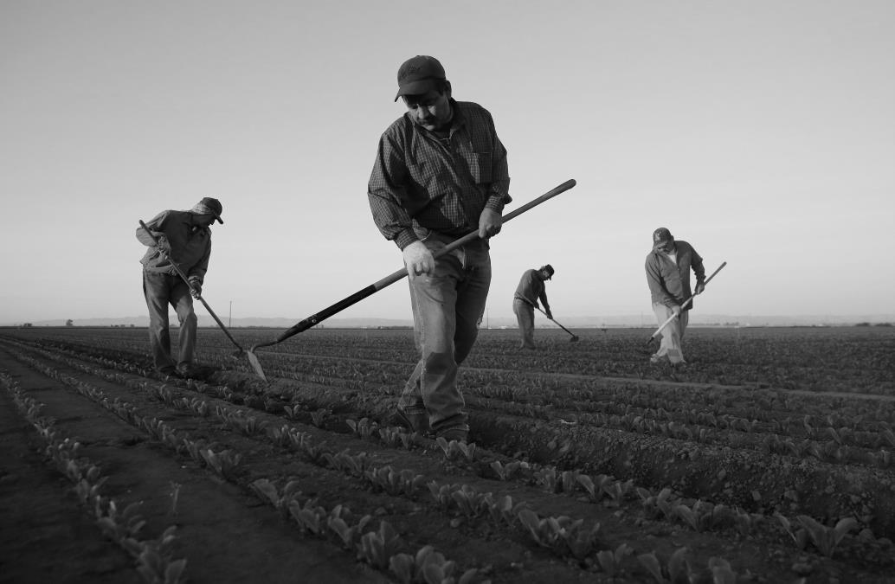
In 2018, approximately 45,100 Monterey County residents encountered food insecurity at some point in the year.
Feeding America, 2018
Poverty rates by race, 2017
DataUSA, 2017
Latinos in California who
worry about where their next meal will come from
are more likely to report serious psychological distress.
Becerra, B. in Preventing Chronic Disease, 2015;12:150334
“If you’re down to your last few dollars and payday is still several days away, you become hyper-aware of how every single dollar is spent. It’s a stressful and exhausting way to live.”
Chris Moss, Health Department
Lee Hulquist, Food Bank
4

Slide 5
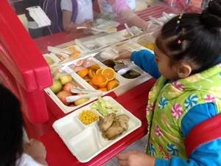
56,119 Monterey County children received school meals in 2018, but only 5,033 received meals during the summer – potentially leaving 51,086 children to experience hunger for three months.
California Food Policy Advocates
Of all county CalFresh recipients in 2018, 11% were pregnant women.
16,000 Participants accessed Monterey County WIC nutrition services in 2018
KidsData.org
Percentage of Monterey County residents who applied for CalFresh assistance and were accepted: July, 2019
49%
Kidsdata.org, 2018
Food Bank of Monterey County serves 10,800 persons per week 2020
California Department of Social Services
Monterey County students participating in the National School Lunch Program
2015-20219
Average number of free/reduced meals served per day in Monterey county schools
2015-2019
50% are children
5
California Department of Education Nutrition Services
California Department of Education Nutrition Services

Slide 6
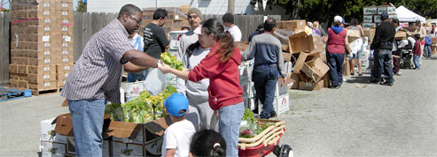
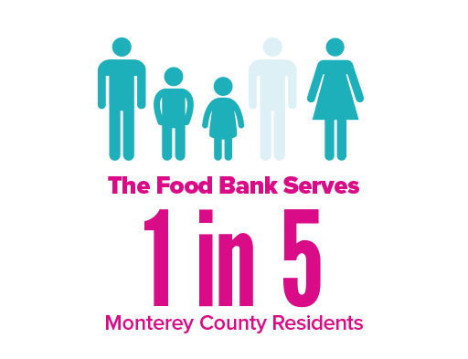
As of April 2020, CalFresh participation can use their Golden State Advantage cards online to purchase groceries! Partner websites include Amazon and Walmart.
Qualifying for CalFresh food assistance:
Can be done online
Can be done in 30 days
Application takes about 10 minutes
Does not affect other benefits
Can be renewed/re-applied
Is not reported to any other government agency
Undocumented parents can apply for their children who have legal status
Monterey County Department of Social Services, 2020
Monterey County Health Department, 2020. For more information see http://www.datasharemontereycounty.org/resourcelibrary or http://www.datasharemontereycounty.org/indicators/index/dashboard?alias=dietandnutrition
https://mc-choice.co.monterey.ca.us/programs/calfresh/
6

